Slide 1

Exploratory Data Analysis
Phone Dataset scrapped from Flipkart
July 05,2020

Slide 2
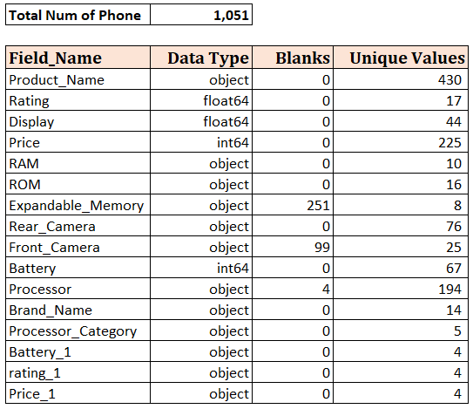
Overview of Dataset
Scrapped 50 pages with 1,051 rows/observations
Dataset has 16 columns, of which 10 are derived fields

Slide 3
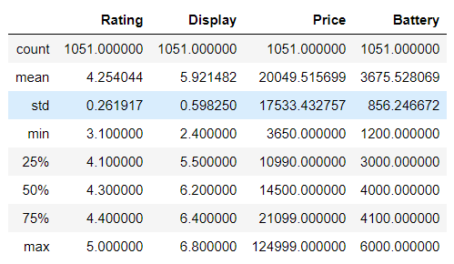
Basic Stats
Data.describe(): gives us basic stats of all numerical variables

Slide 4
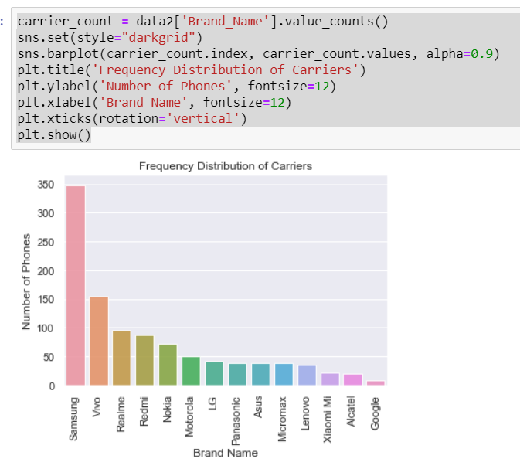
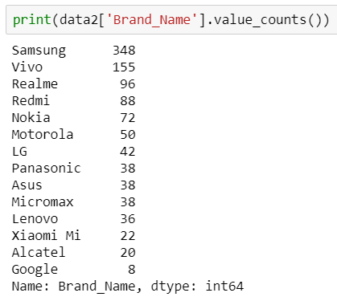
Visualization: Univariate – Brand Name
Brand Name contains 14 unique values
Samsung has the highest number of phones and Google has least

Slide 5
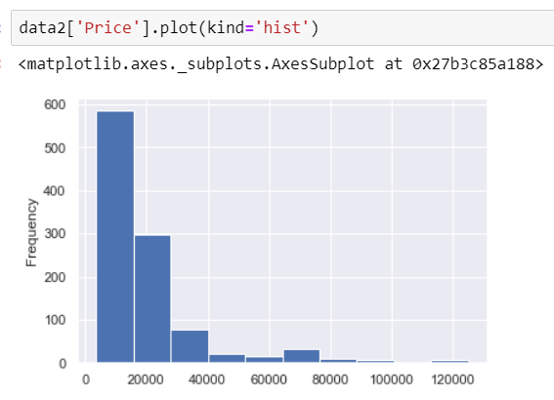
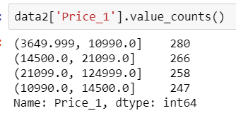
Visualization: Univariate - Price
Price varies from 3,650 to 1,24,999; with a mean of 20,049
Price variable is right skewed
We see maximum number of observations between 10K to 21K

Slide 6
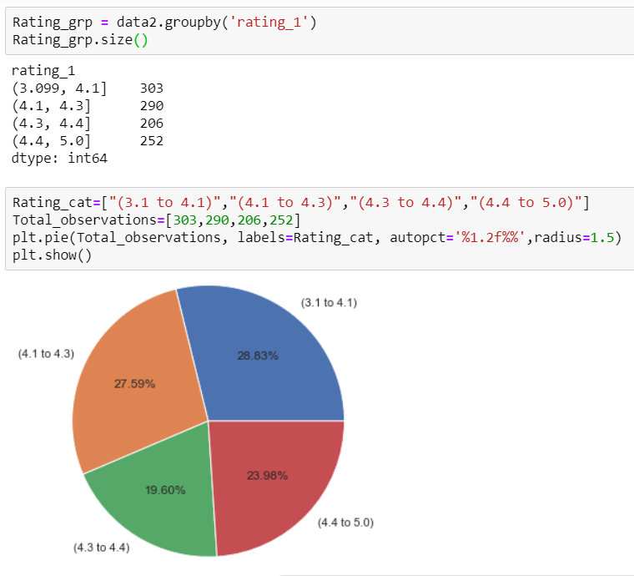
Visualization: Univariate – Rating
Ratings range from 1 to 5, 1 being worst and 5 is best
In the dataset Ratings has values from 3.1 to 5
3.1 to 4.1 – Average ratings
4.1 to 4.3 – Good rating
4.3 to 4.4 – Good rating
4.4 to 5.0 – Excellent ratings
24% of phones have excellent rating

Slide 7
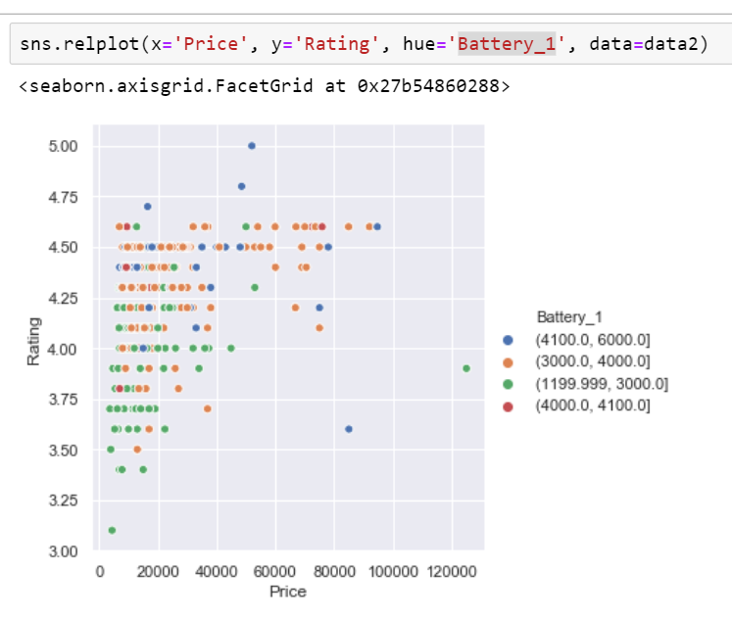
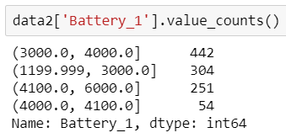
66% of the phones have Battery capacity ranges from 3,000 mAh to 6,000 mAh, where 42% of the phones have battery capacity ranging from 3,000mAh to 4,000 mAh
These 66% are densely populated with rating 4.15 to 4.6
Higher price with less battery capacity = low / avg rating

Slide 8
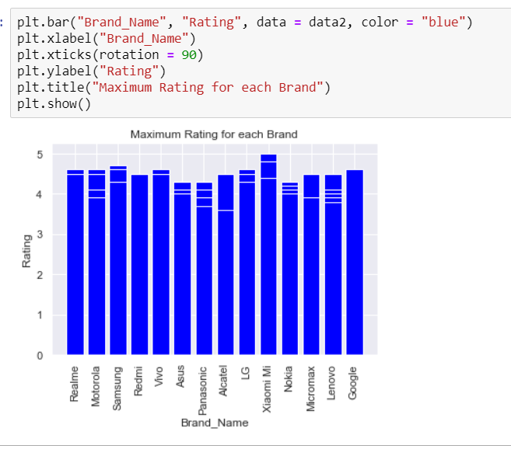
Visualization: Bivariate – Brand Name Vs Rating

